Slide 1
NIKE STORE
GET YOUR GREAT
Made by: Aqsa Iftikhar

Slide 2
OUTLINE
Overview of our business idea and vision.
Marketplace problems aims to be solved
What makes us different
Market opportunities
Offered products
Business models
Marketing strategies
Financial capabilities
Our proposal

Slide 3
BUSINESS GOALS
Nike Store is a cutting-edge online marketplace designed to provide a seamless shopping experience for fitness enthusiasts, athletes, and everyday consumers.
The platform offers a curated selection of premium Nike products, including:
Footwear (e.g., running shoes, sneakers, training shoes).
Apparel (e.g., activewear, sportswear, casual wear).
Accessories (e.g., bags, hats, socks, and fitness gear).
Focused on delivering an unparalleled shopping experience, from browsing to checkout, with features like personalized recommendations, exclusive drops, and fast delivery.

Slide 4
VISION
To revolutionize the sportswear and lifestyle industry by becoming the go-to destination for Nike products.
Empower athletes, fitness enthusiasts, and fashion-forward individuals to elevate their performance and style.
Inspire movement, innovation, and self-expression by providing access to the latest and most exclusive Nike collections.
Build a global community of Nike fans who share a passion for sport, style, and innovation.

Slide 5
The Problem Nike Store Aims to Solve
Lack of Personalization:
Global Accessibility Issues:
Fragmented Shopping Experience:
Customers struggle to find authentic, exclusive, and up-to-date Nike products in one place.
Counterfeit products flood the market, costing Nike billions annually (OECD, 2021).
Existing platforms fail to offer tailored recommendations, despite 80% of consumers preferring personalized experiences (McKinsey).
Many regions lack access to official Nike stores, forcing customers to rely on unofficial channels.
Why It Matters
Addressing these issues is critical to improving customer satisfaction, combating counterfeits, and capturing Nike’s growing global demand, which generated $51.2 billion in revenue in 2023.

Slide 6
WHAT MAKES US DIFFERENT ?
.
Nike Store is a one-stop, customer-centric marketplace that:
Centralizes Authentic Products:
Offers a curated selection of 100% authentic Nike footwear, apparel, and accessories
Exclusive Access:
Provides early and fair access to limited-edition drops and new releases, reducing reliance on resellers.
Personalized Shopping:
Uses AI-driven recommendations to tailor product suggestions based on user preferences and behavior.
Seamless Navigation:
Simplifies product discovery with intuitive categories for performance gear and lifestyle collections.
Global Reach:
Expands access to Nike products in underserved markets through fast, reliable shipping and localized experiences.

Slide 7
MARKET OPPORTUNITIES
The Sportswear Market is Huge:
The global sportswear market is worth $382 billion and growing as people prioritize comfort and style for both workouts and everyday wear.
Nike is a leader in this space, with high demand for its products worldwide.
E-commerce is Booming:
40% of sportswear sales will happen online by 2025, especially in areas without easy access to physical Nike stores.
Key Trends:
Athleisure: Sportswear is now everyday wear, from gyms to offices.
Sustainability: Shoppers want eco-friendly options, and Nike delivers with products like recycled sneakers.
Tech-Driven Shopping: Personalized recommendations and virtual try-ons are becoming essential.

Slide 8
OFFERED PRODUCTS

Slide 9
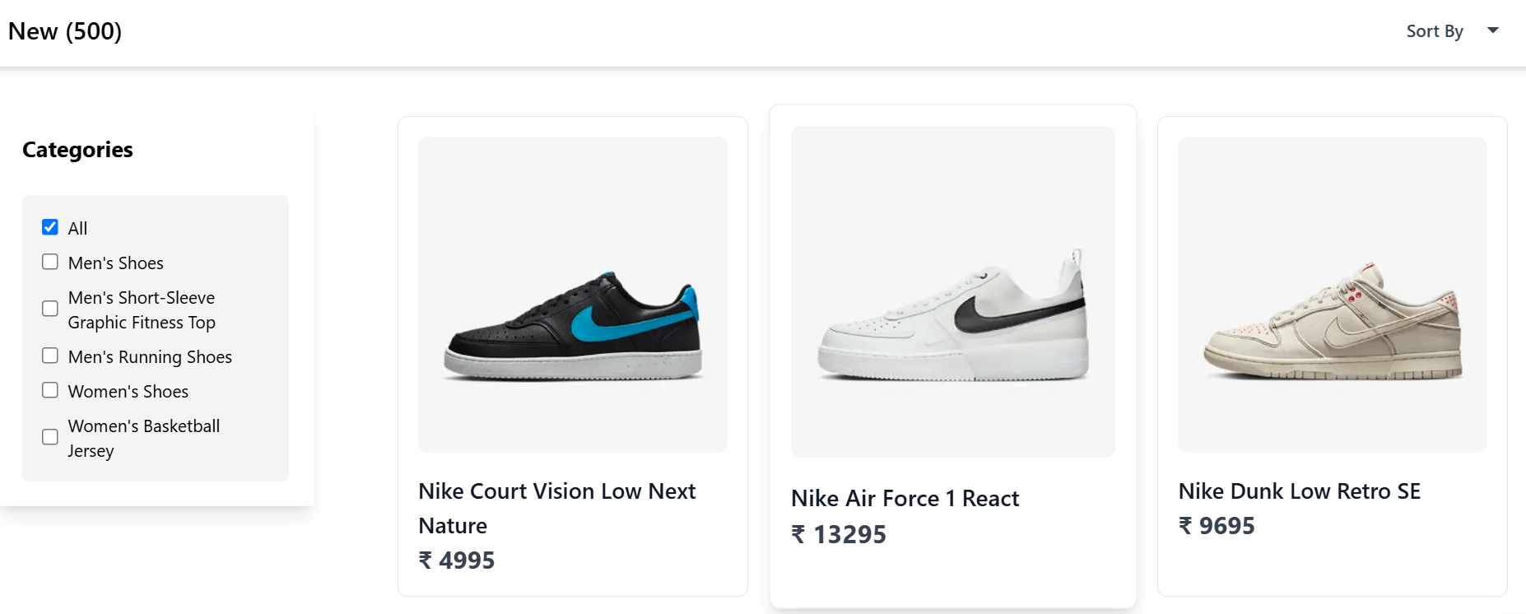
PRODUCTS PAGE:
“Our Products Page is designed for effortless browsing. With intuitive filters and sorting options, users can quickly find the perfect Nike product, whether it’s running shoes, workout gear, or casual sneakers.”

Slide 10
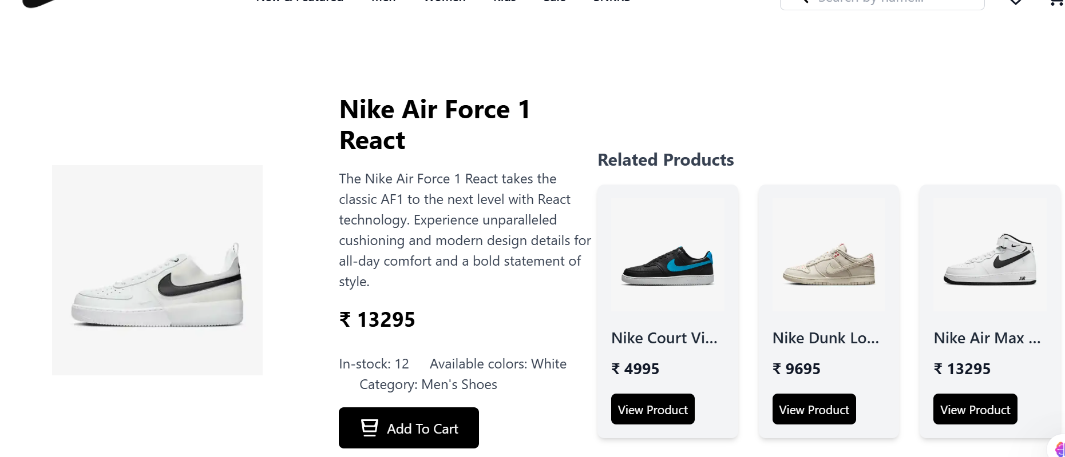
PRODUCT DETAIL PAGE:
“The Product Detail Page ensures users have all the information they need. From high-quality images and detailed descriptions to customer reviews, it’s built to inspire confidence and drive purchases. It shows users related products as well!”

Slide 11
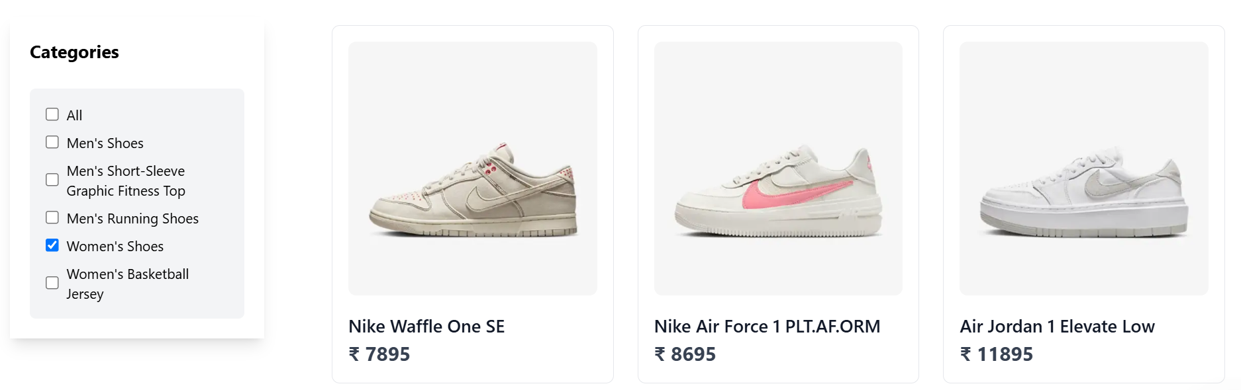
PRODUCT FILTERING . “We also offers filtering feature to ensure people can browse easily. ”

Slide 12
BUSINESS MODEL . Nike Store will make money in these ways:
Commission on Sales:
Take a small cut (5-10%) from every sale made on the platform.
Example: If a pair of Nike shoes sells for 100$, NikeStore earns 5-10$.
Ads on the Platform:
Brands can pay to run ads targeting specific customers.
Example: A running shoe brand pays to show ads to users searching for workout gear.
Promoted Listings:
Sellers can pay to have their products shown at the top of search results.
Example: A seller pays $50 to feature their product for a week.

Slide 13
MARKETING STRATEGIES
Social Media Campaigns:
Use platforms like Instagram, TikTok, and YouTube to showcase Nike products.
Collaborate with influencers and fitness enthusiasts to promote the platform.
Exclusive Drops and Hype Building:
Create buzz around limited-edition releases (e.g., Air Jordans).
Use countdowns, teasers, and email alerts to build excitement.
Example: “Only 100 pairs available—be the first to grab them!”
SEO and Content Marketing:
Optimize the website for search engines to rank higher for terms like “buy Nike shoes online” or “best Nike running gear.”

Slide 14
FINANCIAL CAPABILITIES
How Much Money We’ll Make (Year 1):
We’ll sell 200 products a month at $100 each.
That’s $20,000 in sales every month.
We’ll take a 10% cut from each sale, so $2,000/month.
We’ll also earn from:
Featured listings: $1,000/month (sellers paying to promote their products).
Exclusive drops: $500/month (extra income from limited-edition releases).
Ads: $500/month (brands paying to advertise on the platform).
Total monthly income: $4,000.
Year 1 income: $48,000.
How Much We’ll Spend (Year 1):
Building the platform: $30,000 (one-time cost for design and development).
Marketing: $15,000 (social media ads, influencer collaborations, and SEO).
Running costs: $10,000 (hosting, customer support, and logistics).
Total Year 1 costs: $55,000.
Profit (Year 1):
Income: $48,000.
Costs: $55,000.
Loss: $7,000 (expected in the first year as we grow).

Slide 15
OUR PROPOSAL We’re looking for $55,000 in funding to bring Nike Store to life and revolutionize the way people shop for Nike products.
In return, you’ll get:
A 10% equity stake in Nike Store.
Early access to exclusive drops and platform updates.
The opportunity to be part of a fast-growing, innovative marketplace.
Here’s how your support will help:
Build the Platform: $30,000 for design, development, and testing.
Launch Marketing Campaigns: $15,000 for social media ads, influencer collaborations, and SEO.
Cover Operational Costs: $10,000 for hosting, customer support, and logistics.
Join us in building the ultimate destination for Nike fans.
Let’s create a platform that inspires movement, style, and innovation.
Contact us today to invest or partner! 📧 Email: aqsaiftikhar@gmail.com 📞 Phone: 032*******7

